Slide 1
Type Conversions and Casting
Kaustubh Kulkarni

Slide 2
Automatic Conversion
When one type of data is assigned to another type of variable, an automatic type conversion will take place if the following two conditions are met:
The two types are compatible.
The destination type is larger than the source type.
When these two conditions are met, a widening conversion takes place.
For example, an int type variable is large enough to hold byte values.
For widening conversions, the numeric types, including integer and floating-point types, are compatible with each other.

Slide 3
Examples:
// assigning byte to short
byte b = 127;
short s = b; // Valid, byte is smaller than short
// assigning short to int
int i = s; // Valid, short is smaller than int
// assigning int to long
long l = i; // Valid, int is smaller than long
// assigning int to float
float f = i; // Valid, int is smaller than float
// assigning float to double
double d = f; // Valid, float is smaller than double

Slide 4
Refer sizeOf.java
Refer AutomaticConversions.java

Slide 5
Storing Literals
Java also performs an automatic type conversion when storing a literal integer constant into variables of type byte, short, long, or char.

Slide 6
Example
byte b = 10;
// Valid, 10 is within the range of byte (-128 to 127)
short s = 20000;
// Valid, 20000 is within the range of short (-32768 to 32767)
long l = 9223372036854775807L;
// Valid, 9223372036854775807 is within the range of long
char c = 'A’;
// Valid, 'A' is a character with a corresponding Unicode value

Slide 7
Narrowing Conversions
Although the automatic type conversions are helpful, they will not fulfill all needs.
For example, what if you want to assign an int value to a byte variable?
This conversion will not be performed automatically, because a byte is smaller than an int.
This kind of conversion is sometimes called a narrowing conversion, since you are explicitly making the value narrower so that it will fit into the target type.

Slide 8
Casting
To create a conversion between two incompatible types, you must use a cast.
A cast is simply an explicit type conversion.
It has this general form: (target-type) value
Here, target-type specifies the desired type to convert the specified value to.
For example, the code fragment in the following slide casts an int to a byte.
If the integer’s value is larger than the range of a byte, it will be reduced modulo (the remainder of an integer division by the) byte’s range.

Slide 9
int a;
byte b;
// …
b = (byte) a;

Slide 10
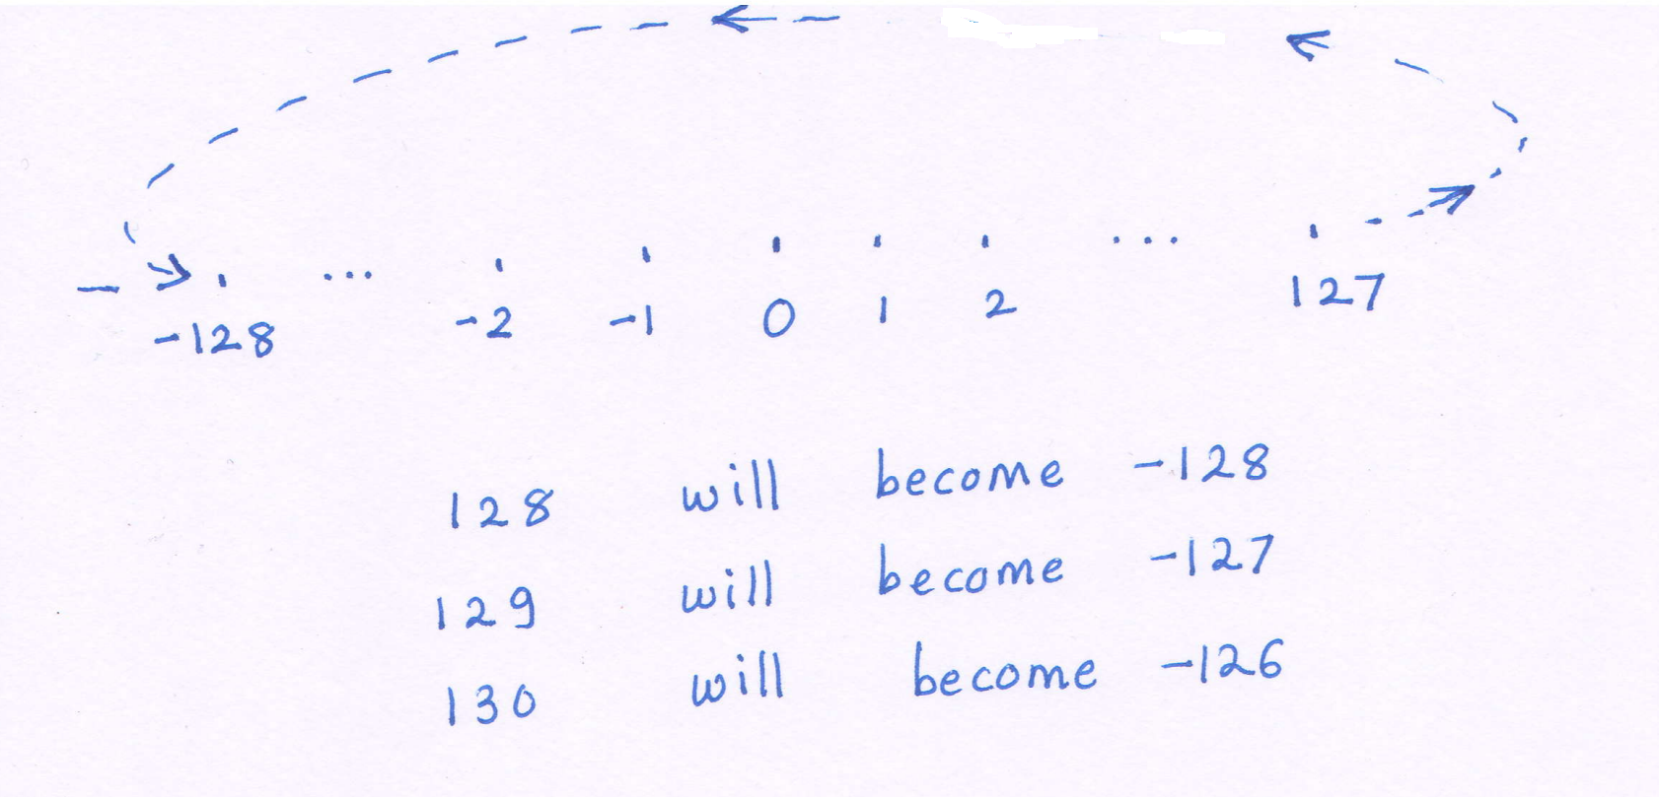
Byte Overflow illustration

Slide 11
Byte overflow and underflow
Overflow
-128
-127
-3
-2
-1
0
1
2
3
126
127
Underflow

Slide 12
Truncation
A different type of conversion will occur when a floating-point value is assigned to an integer type: truncation.
As you know, integers do not have fractional components.
Thus, when a floating-point value is assigned to an integer type, the fractional component is lost.
If the size of the whole number component is too large to fit into the target integer type, then that value will be reduced modulo the target type’s range.

Slide 13
Automatic Type Promotion in Expressions
byte a = 40;
byte b = 50;
byte c = 100;
int d = a * b / c;

Slide 14
byte b = 50;
b = b * 2; // Error! Cannot assign an int to a byte!

Slide 15
byte b = 50;
b = (byte)(b * 2);

